Slide 1
Content management project for Speedo Tours
Made by:
Nour Eldeen Mohamed
Khaled Nader Elgammal
Ramez Nabil Fahmy
Ahmed Mohamed Salah Mahdy
Supervised By: Dr.Essam Eliwa

Slide 2
Revised Problem Statement.
The main problem the web application was created for improving was that the company didn’t use any software in order to keep track of their data , the whole sequence was made manually. Also the booking of a hotel or a package was made manually by contacting the company in order to view current offers and book a hotel or a package through them.

Slide 3
System Overview
The client is able to preform couple of things like booking , reviewing a hotel or a package. Also the user is able to send an inquiry to the support center about a specific hotel or a package.
The support operator is able to reply to inquires of guests and send the latest news to subscribed guests.
The admin is able to add hotels , packages or edit the main page content and about us page content. Also the admin is able to confirm a reservation of a guest or deny the reservation.

Slide 4
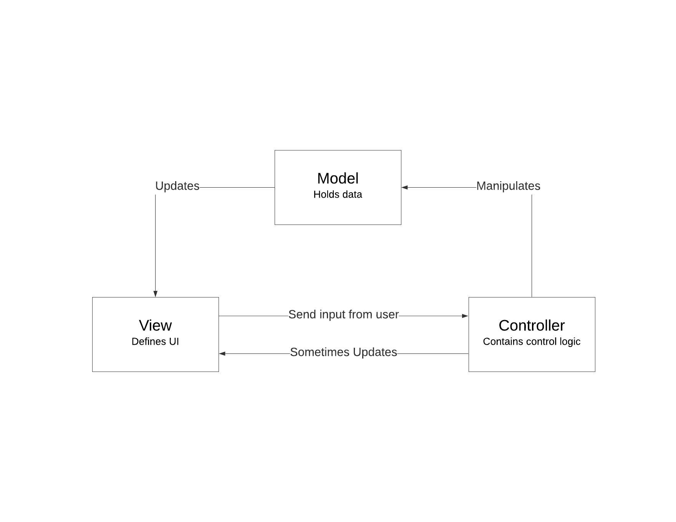
Architectural design:

Slide 5
Logical Viewpoint
The system is designed according to the MVC architecture. The view has the user interface, Controller transfers the data inserted from the view to the model to be implemented in functions and the model holds the data of the class and also has the implementation of the functions that operate on the data to produce the output requested.

Slide 6
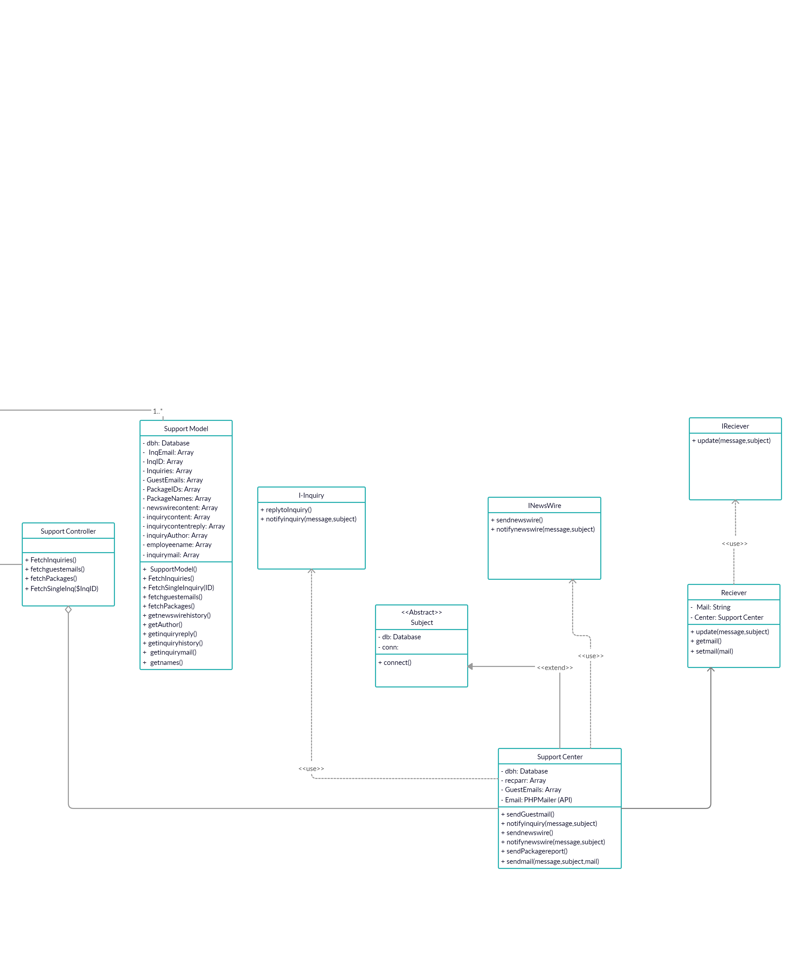
Patterns use viewpoint (Observer pattern)

Slide 7
Observer pattern
The pattern is implemented to let the support operator send emails and reply to inquiries by email in addition to sending the news wire to subscribed users.
Rationale: We implemented it to be able to provide the users with updates and mails internally with the use of an official mail sanctioned by the company.

Slide 8
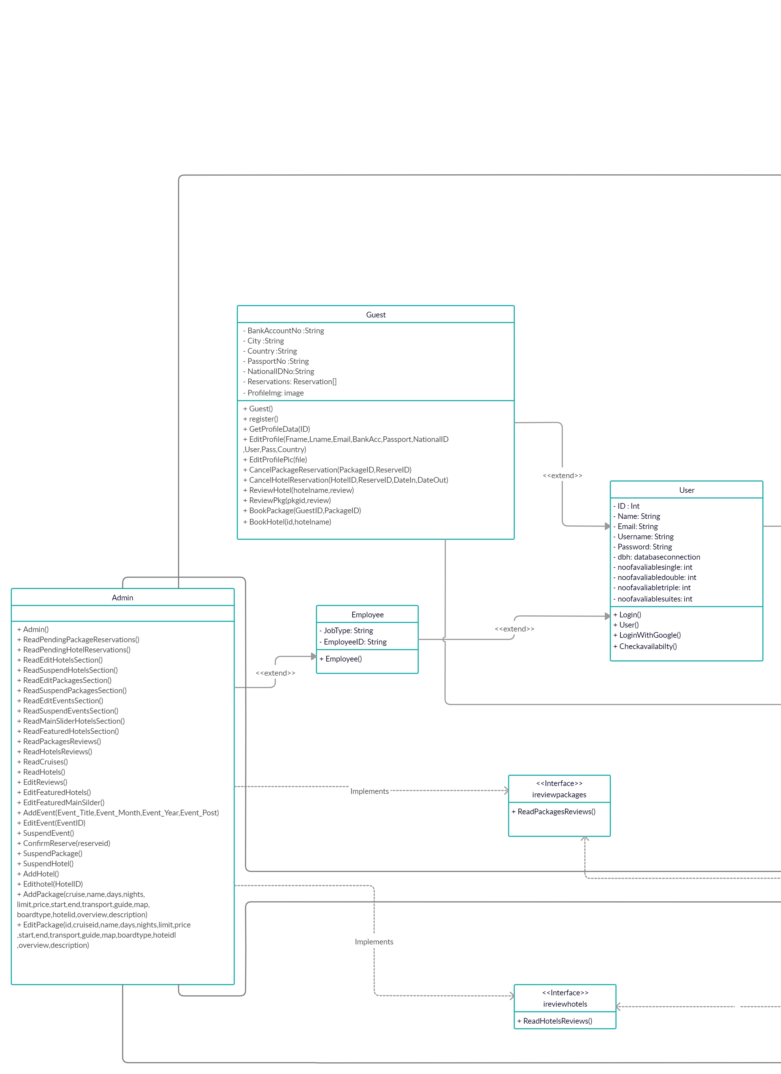
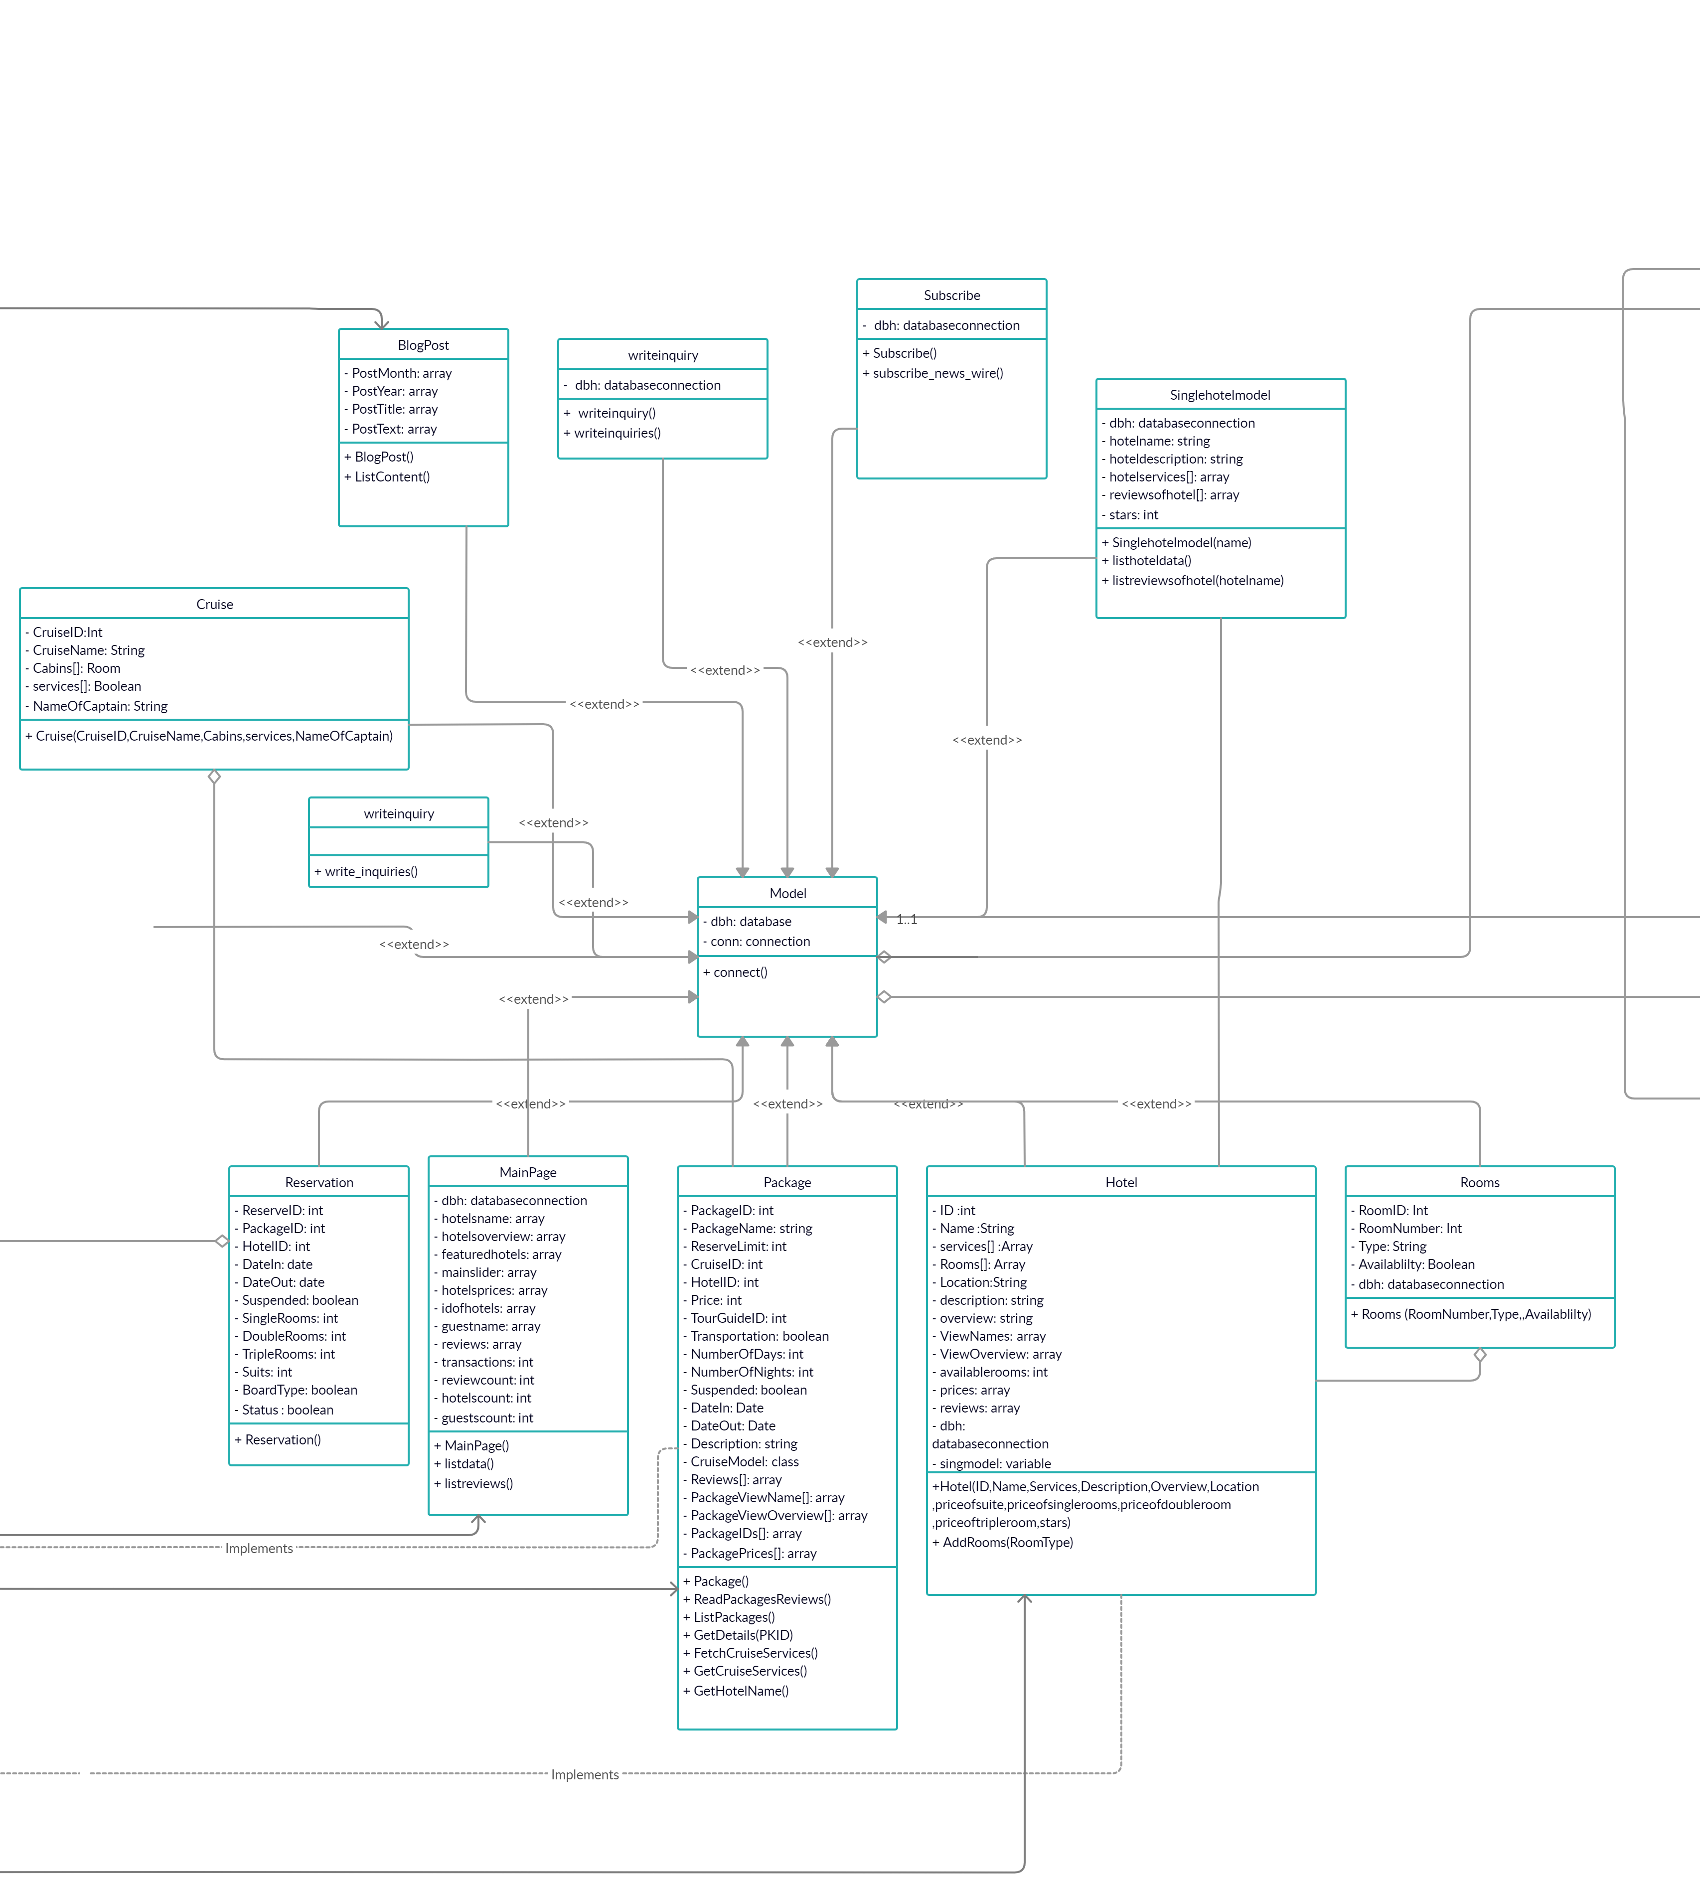
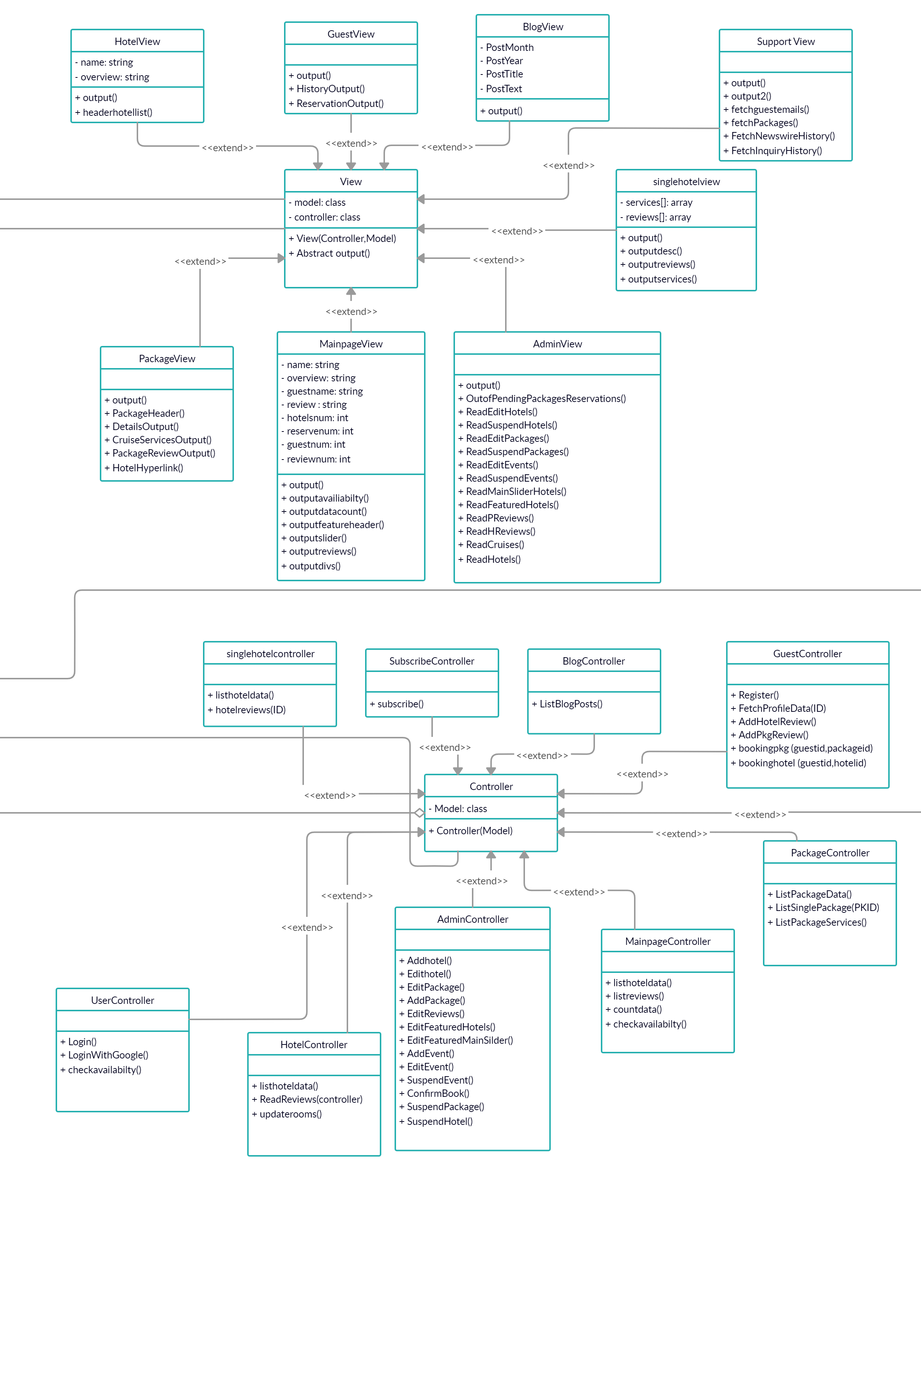
MVC

Slide 9
MVC pattern
The pattern works as follows, Every class that holds data and manipulate it or perform function on it extends or inherits from Model super class. Then, the controllers that are responsible for transferring data from View to Model and calling the desired functions inherit from the Controller super class. Finally, the view class that are responsible for the output of the data stored by the Model inherit from the super class View.
Rationale: The reason behind selecting the MVC approach is to separate functionality from data and representation in order to avoid damage or unexpected conflicts in data.

Slide 10
Structure Viewpoint 1

Slide 11
Structure viewpoint 2

Slide 12
Structure viewpoint 3

Slide 13
Structure viewpoint 4

Slide 14
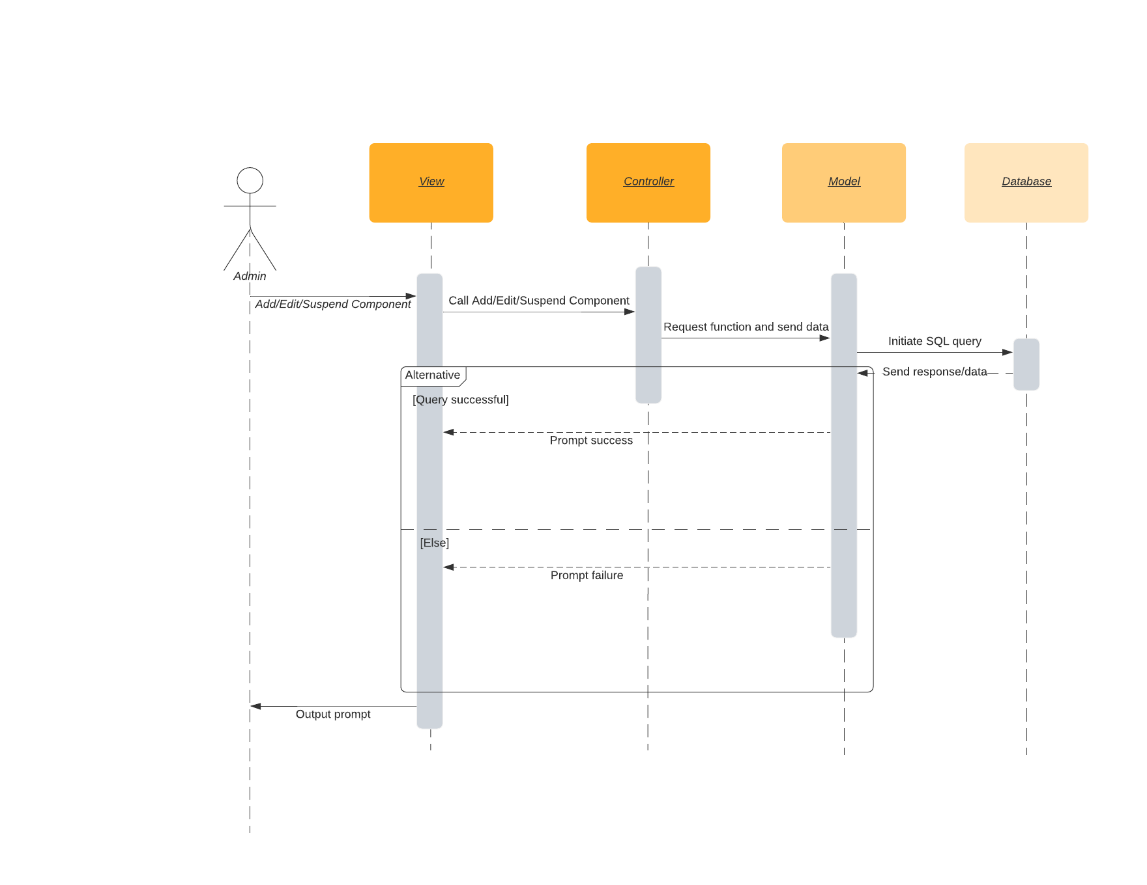
Interaction viewpoint
Admin functions

Slide 15
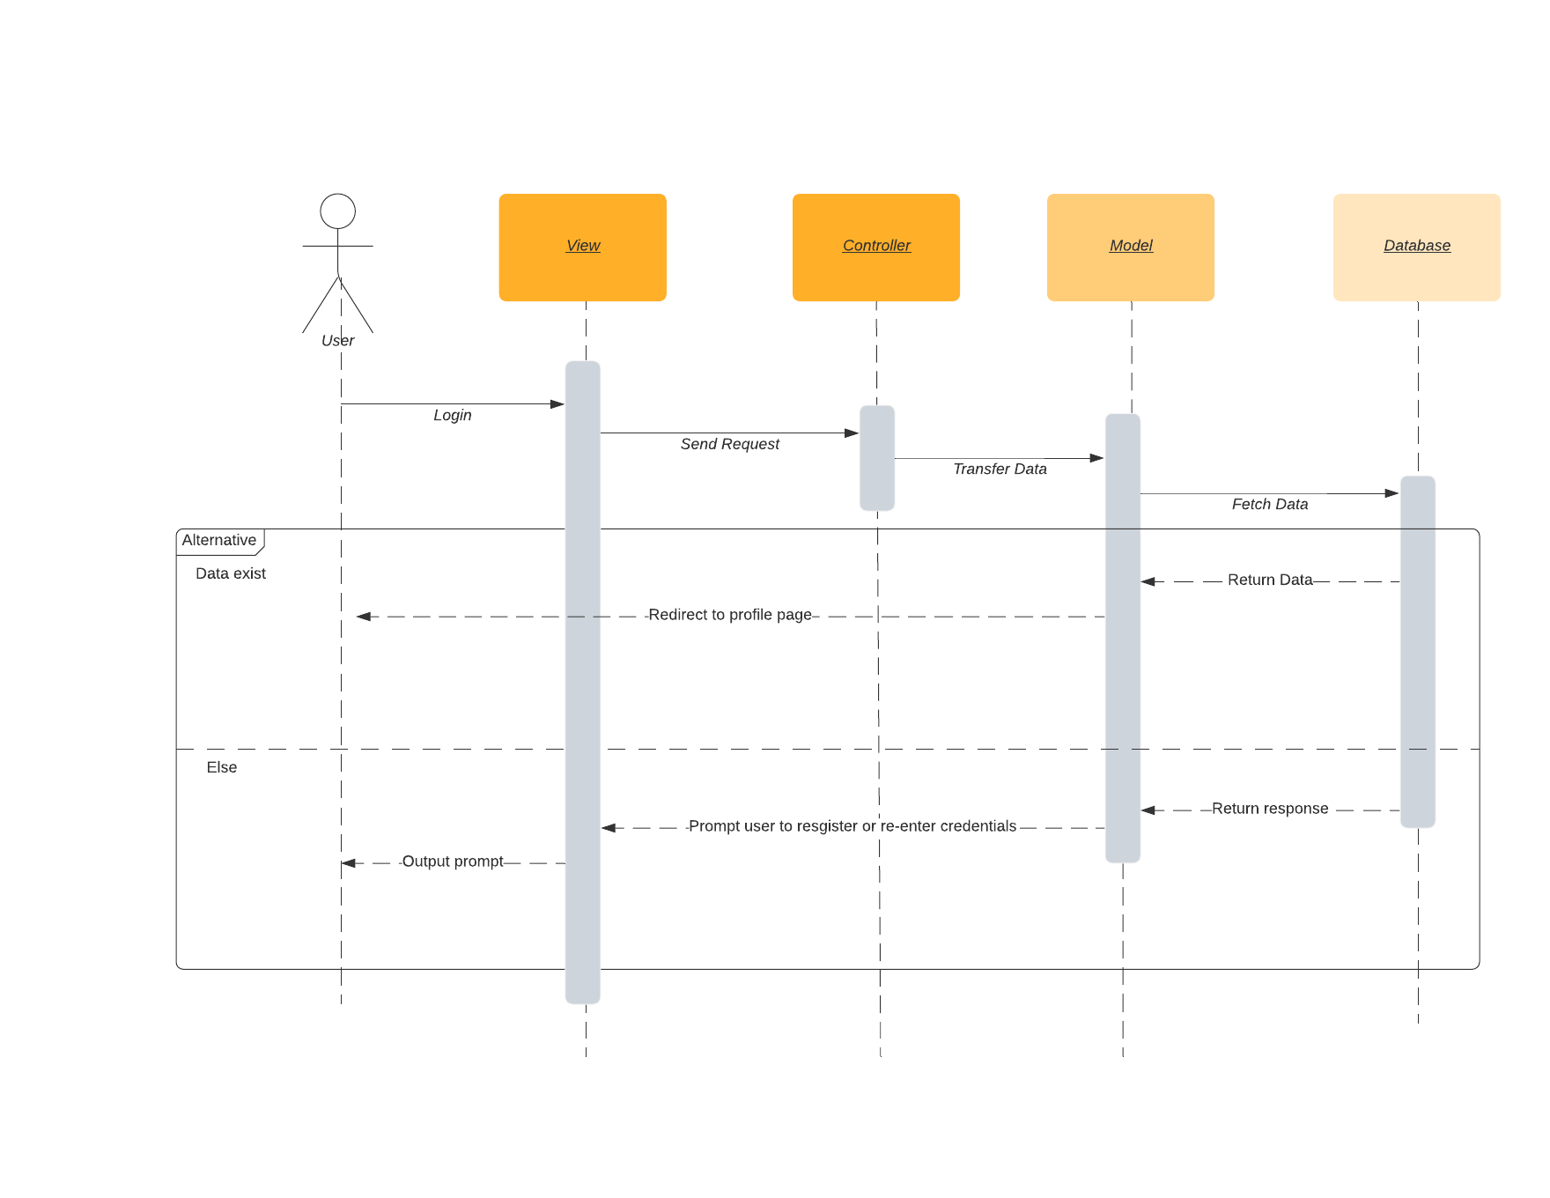
User Login

Slide 16
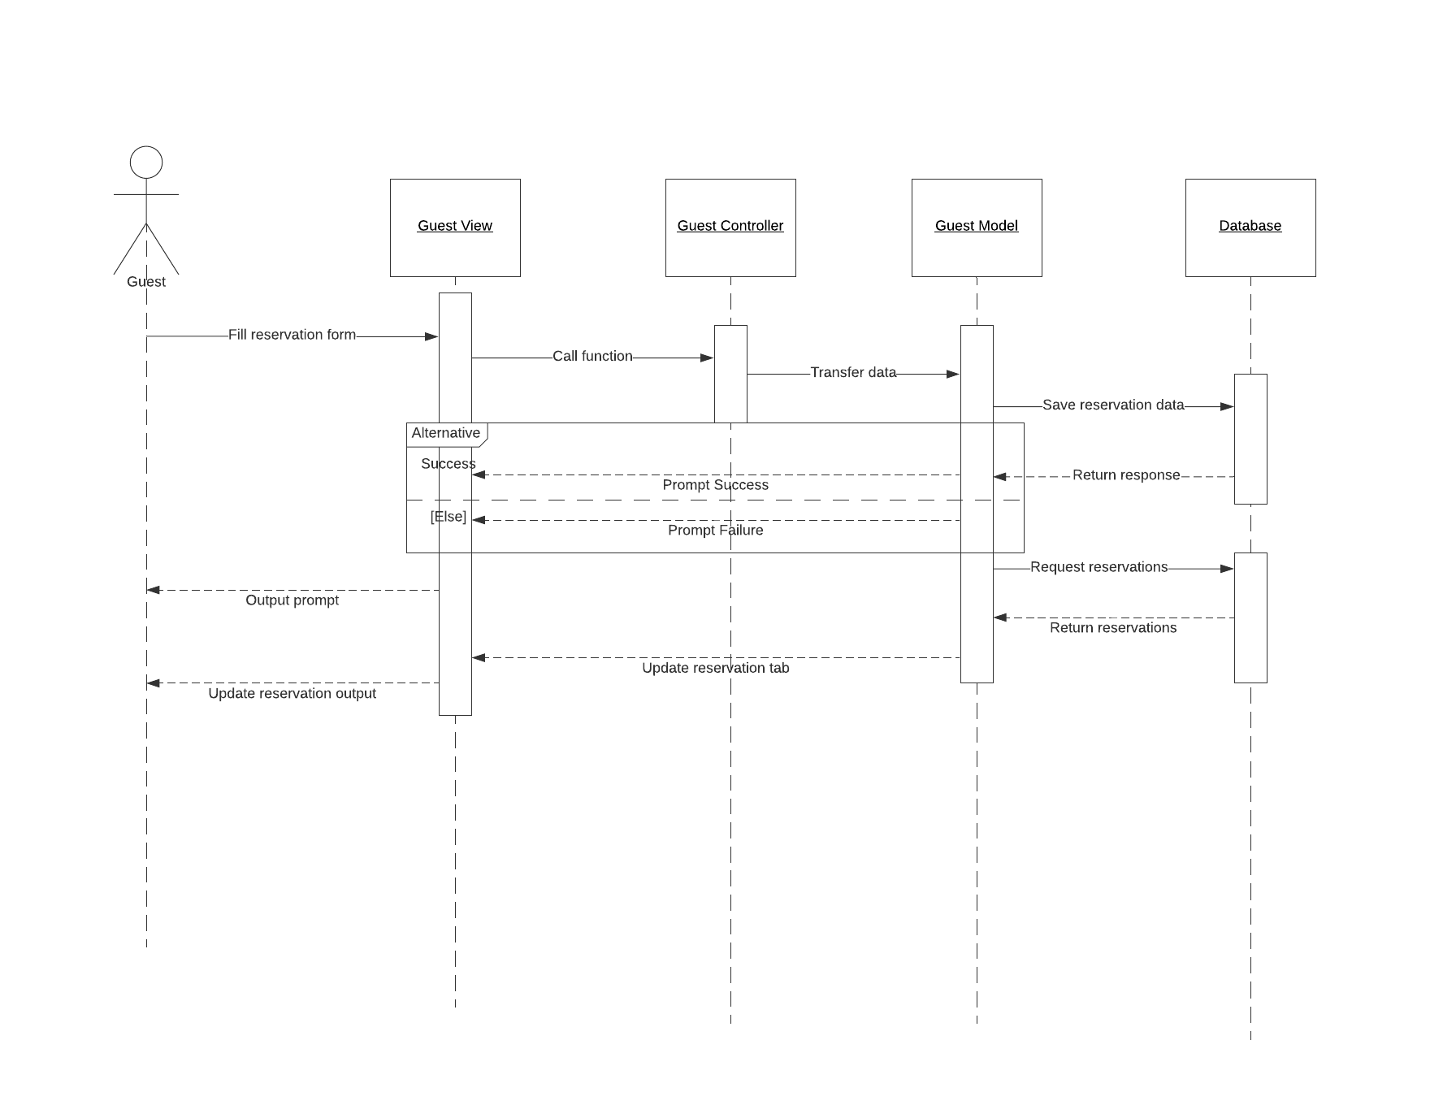
Booking

Slide 17
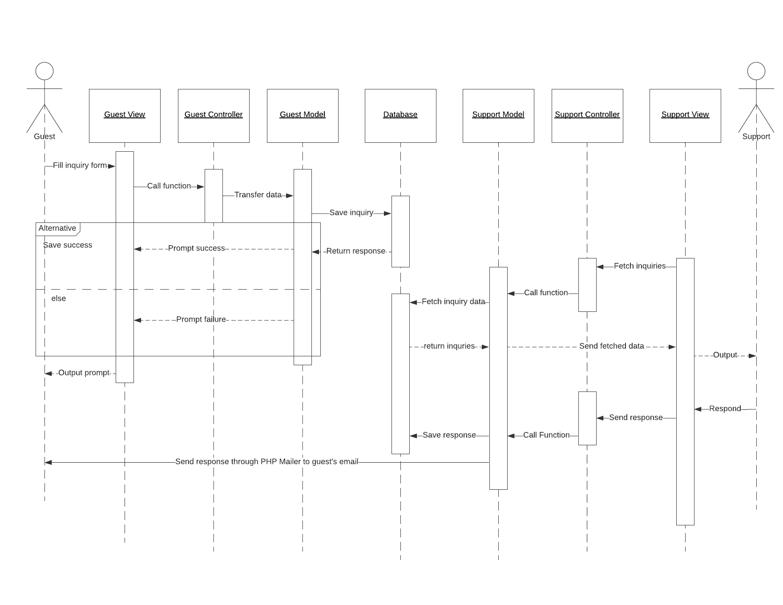
Guest and Support interactions

Slide 18
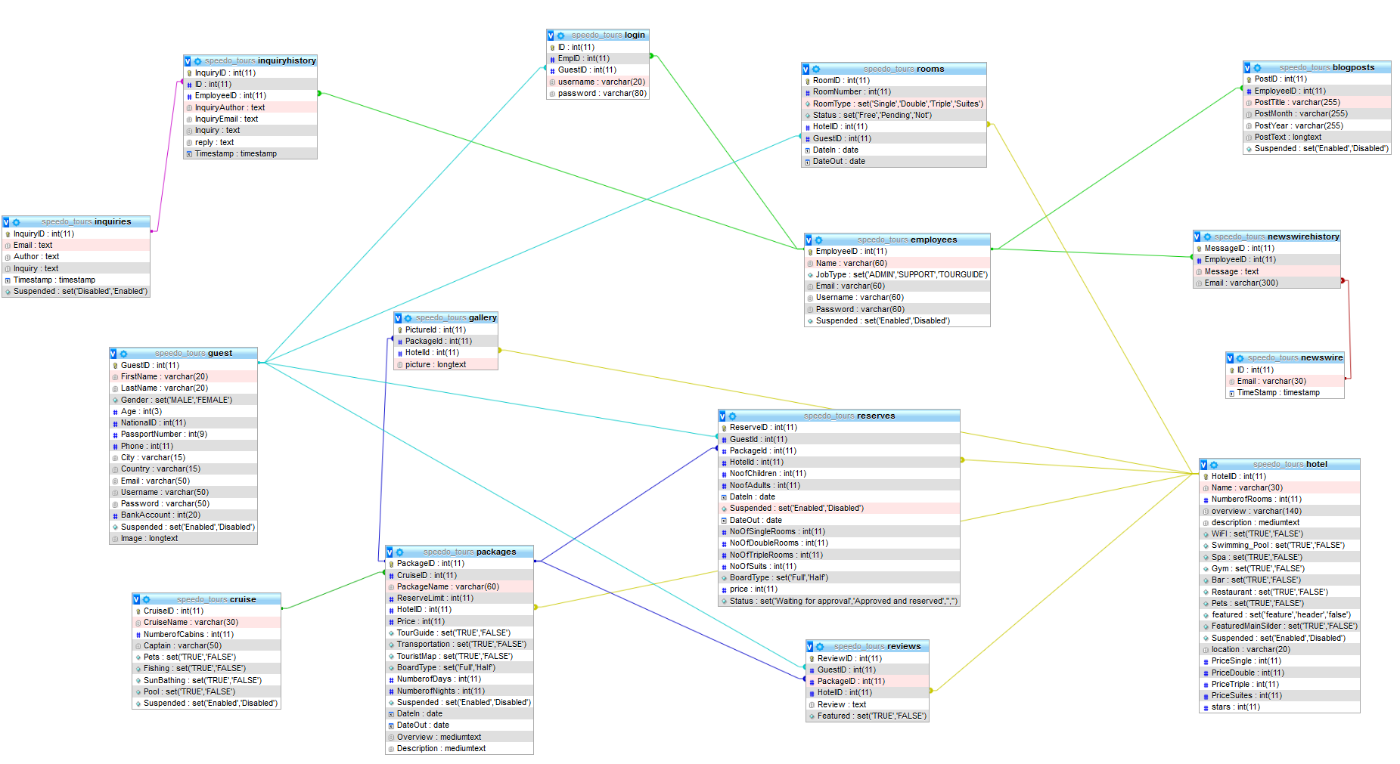
Database Design

Slide 19
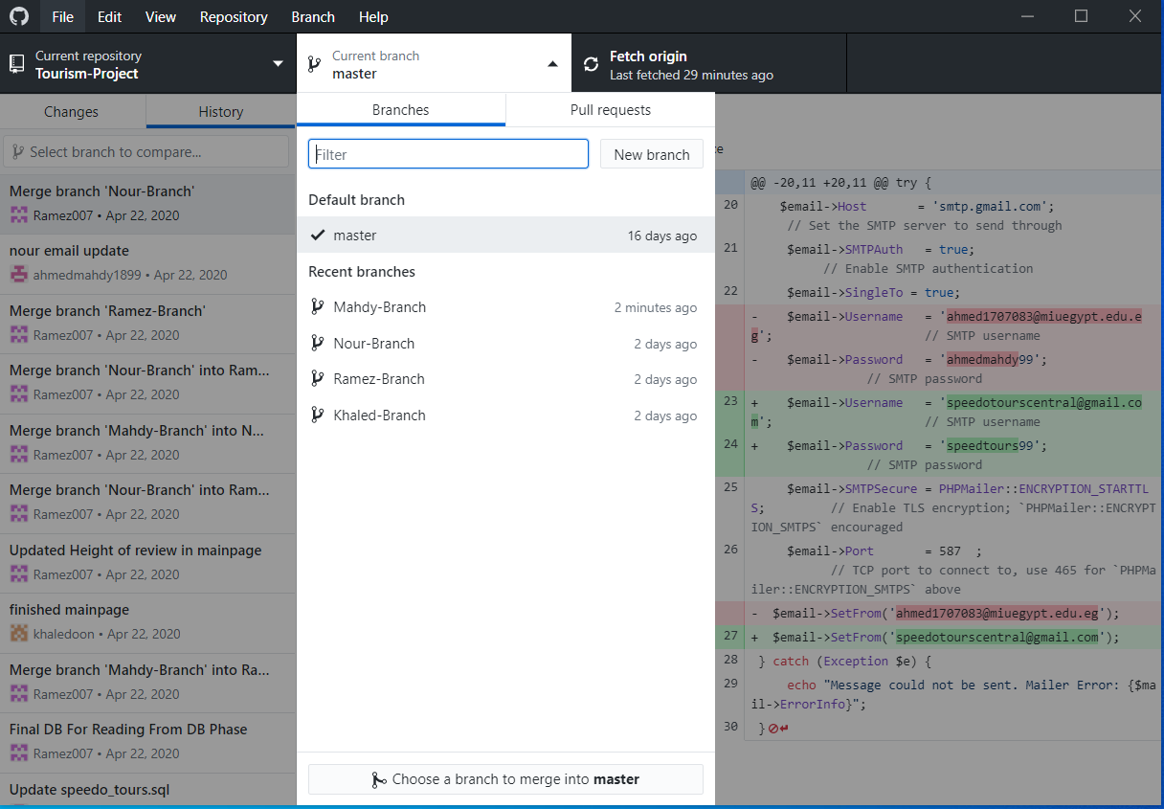
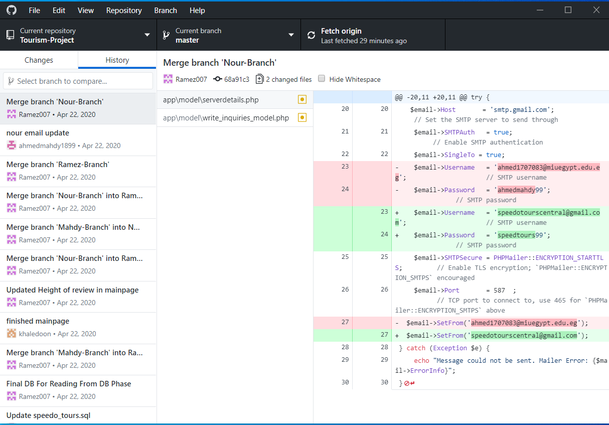
GitHub
Link : https://github.com/Ramez007/Tourism-Project
Images:

Slide 20
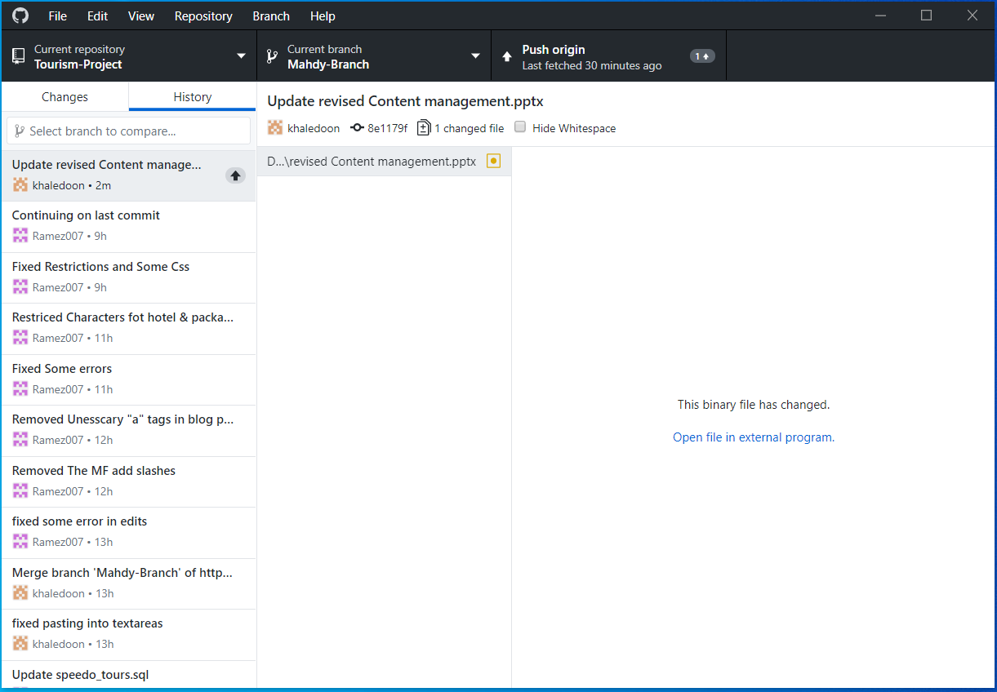
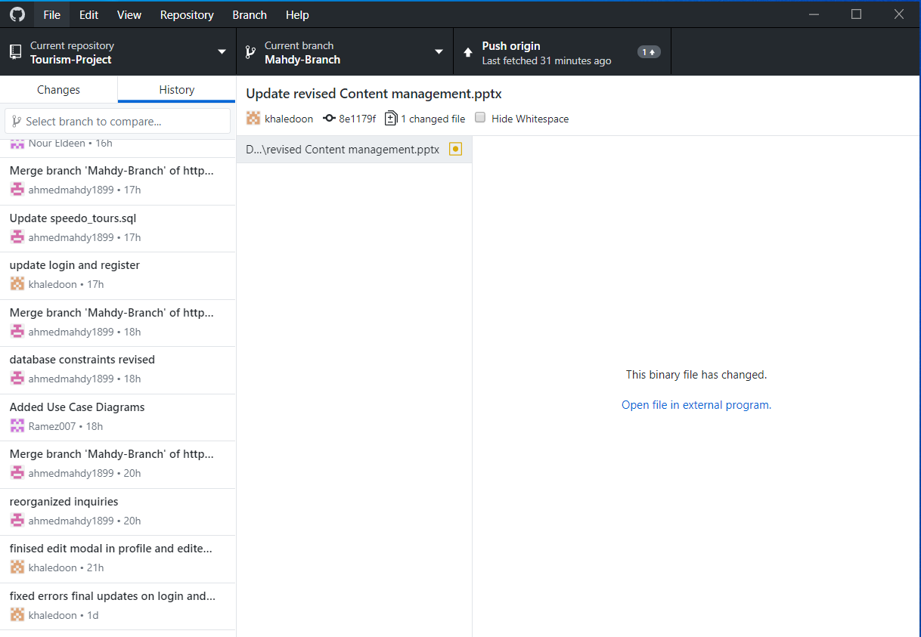

Slide 21
